Slide 1
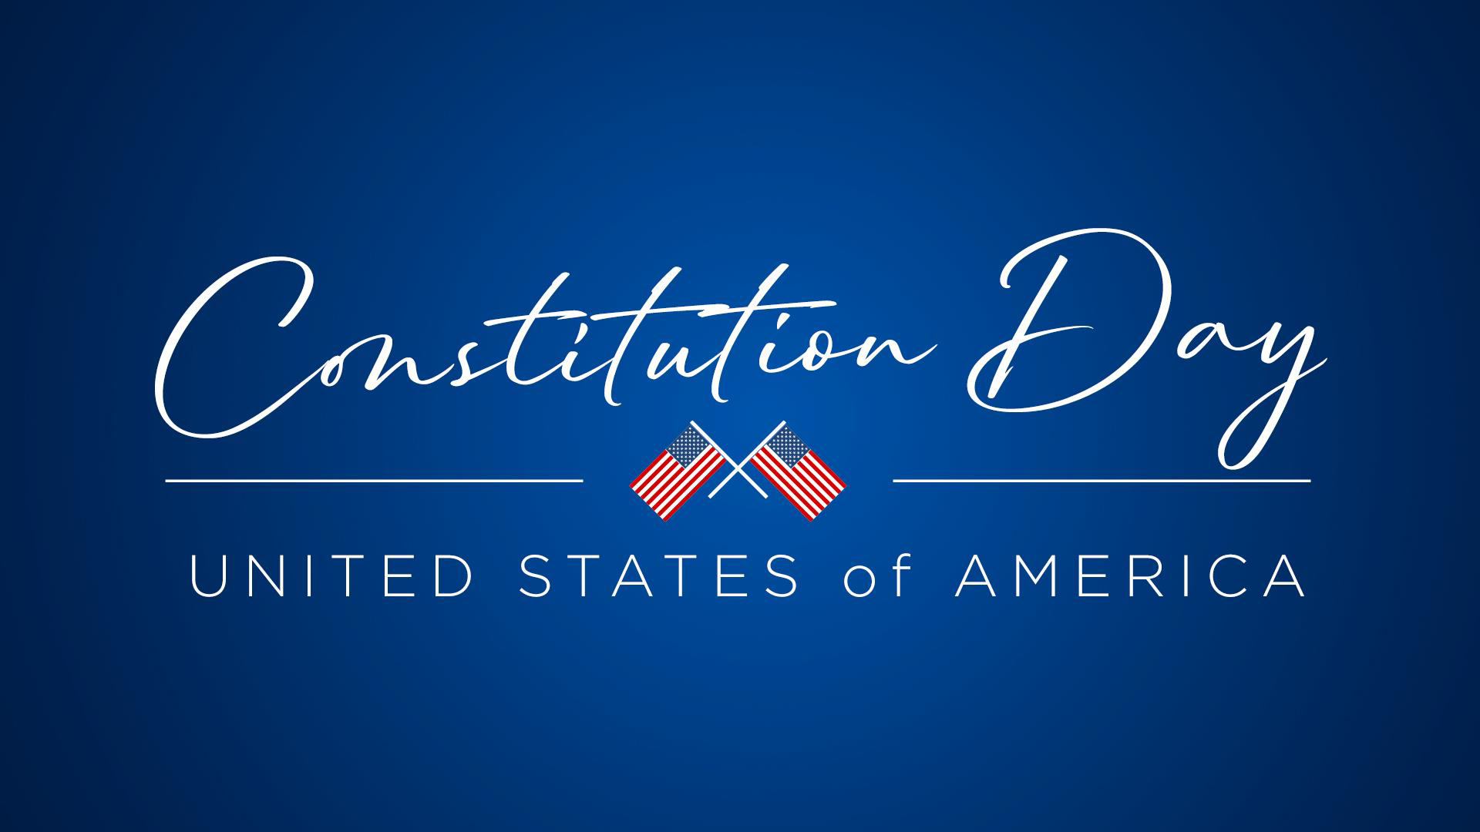

Slide 2
PURPOSE
The purpose of Constitution Day and Citizenship Day is to ensure that students in America have an increased knowledge and appreciation of this valuable and important document of freedom.
The Constitution is a handwritten document which is over 200 years old.
It is a living document that protects American citizens’ rights and freedoms.
Constitution Day is recognized each year on September 17, which is the date that the original document was adopted in 1787.

Slide 3
BACKGROUND
The 13 original colonies were united by the Articles of Confederation in 1787.
There were problems because the Articles did not provide a strong government.
Just a few of these problems were that the government had no power to collect taxes, no power over trade or commerce and no control over money -- each state could print its own.
On May 25, 1787 in Philadelphia, PA, delegates from 12 states gathered to begin a convention where they planned to rewrite the laws in the Articles of Confederation.
Philadelphia, the largest and most modern city at the time, was picked to host the convention because it was in the geographic middle of the states.

Slide 4
COMPOSITION
The Constitution is comprised of the:
  Preamble
  Articles
  Amendments

Slide 5
PREAMBLE
The preamble is the introduction to the Constitution.
It outlines the general goals of the framers: to create a just government, ensure peace, provide an adequate national defense, and promote a healthy, free nation.
With its first three words, “We the People,” the preamble emphasizes that the nation is to be ruled by the people - not a king or dictator, not the president, Supreme Court Justices, members of Congress or state legislators.
The Supreme Court held in 1905 (in Jacobson v. Massachusetts) that the preamble is not a source of federal power or individuals’ rights.
All rights and powers are set out in the articles and amendments that follow.

Slide 6
PREAMBLE
“
We the People of the United States, in Order to form a more perfect Union, establish Justice, insure domestic Tranquility, provide for the common defense, promote the general Welfare, and secure the Blessings of Liberty to ourselves and our Posterity, do ordain and establish this Constitution for the United States of America.
“

Slide 7
ARTICLES
Article I covers the Congress or legislative branch.
Article II covers the President or executive branch.
Article III covers judges and national courts or judicial branch.
Article IV covers how the states relate to each other and the national government.
Article V covers how the Constitution can be changed.
Article VI covers how the Constitution is the supreme law of the land.
Article VII covers the ratification of the document.

Slide 8
BILL OF RIGHTS
The Bill of Rights are the first ten amendments to the Constitution.
The Bill of Rights was not included in the 1787 Constitution.
The Bill of Rights were ratified on December 15, 1791.

Slide 9
BILL OF RIGHTS
First Amendment - Freedom of Religion, Speech and the Press; Right of Assembly and Petition.
Second Amendment - Right to Bear Arms
Third Amendment - Housing Soldiers
Fourth Amendment - Search and Arrest Warrants
Fifth Amendment - Rights in Criminal Cases
Sixth Amendment - Right to a Fair Trial

Slide 10
BILL OF RIGHTS
Seventh Amendment - Rights in Civil Cases
Eight Amendment - Bails, Fines, and Punishments
Ninth Amendment - Rights Retained by the People
Tenth Amendment - Powers Retained by the States and the People

Slide 11
CHANGES TO THE CONSTITUTION
After the Bill of Rights, an additional 17 amendments have been made to the Constitution.
The most recent change to the Constitution was made in 1992.

Slide 12
SIGNING + RATIFICATION
George Washington was the first of the delegates to sign.
Delegates signed in order from the northern states to the southern states.
Only 39 of the delegates actually signed, not all approved of the document.
After being signed, it became part of a 6 page report sent to the Congress.
Congress accepted the report and sent it to the states for their approval.
It was ratified by nine of the 13 states by June 21, 1788 - becoming the law of the land.
After the text of the Constitution had been agreed upon, Jacob Shallus, an assistant clerk of the Pennsylvania State Assembly, was the penman who wrote the document prior to signing.

Slide 13
ADDITIONAL FACTS
How long did it take to frame the Constitution?
It was drafted in one hundred working days.
Who was called the “Father of the Constitution?”
James Madison of Virginia
Which state was the first to ratify the Constitution?
Delaware
How many pages long is the Constitution?
Four
Which state didn’t send any delegates to the convention?
Rhode Island
Does the Constitution give us our rights and liberties?
No, it only guarantees them.

Slide 14
SOURCE
Johnson, T.L. (Ed.). (2007). The U.S. Constitution and fascinating facts about it. Naperville, IL: Oak Hill Publishing Company.

